Slide 1
Evolving Web Technologies Ass 1: Responsive Design
Joana Roche – K00223364
__________________________________________________________________________________________________________________________________
The Healthy Circle website
Concept
News about health, aimed to public, healthcare students and professionals. Articles about Natural Health.

Slide 2
Evolving Web Technologies Ass 1: Responsive Design
Joana Roche – K00223364
__________________________________________________________________________________________________________________________________
The Healthy Circle website
Navigation:
Login button
Home
Latest news
News
Natural health
Articles
Nutrition
Links
Search bar
Home
Login
News
Recent
Natural Health
Search
All news
Articles
Nutrition
Links

Slide 3
Evolving Web Technologies Ass 1: Responsive Design
Joana Roche – K00223364
__________________________________________________________________________________________________________________________________
The Healthy Circle website
Moodboard
The Healthy Circle

Slide 4
Evolving Web Technologies Ass 1: Responsive Design
Joana Roche – K00223364
__________________________________________________________________________________________________________________________________
The Healthy Circle website
Persona
The audience for the Healthy Circle website is the general public and/or healthcare professionals/students.

Slide 5




James
Key goals
Be well-informed about the health field
Have good influences for his studies
Behaviours
Likes to know the latest news about health, new studies/findings
Likes to read articles from future competitors
Wants to keep himself healthy
“Health is not simply the absence of sickness.”
Hannah Green
Frustrations
Age 26
Occupation Natural Medicine Student
Cluttered news websites (time consuming)
Distracting flashing images

Slide 6
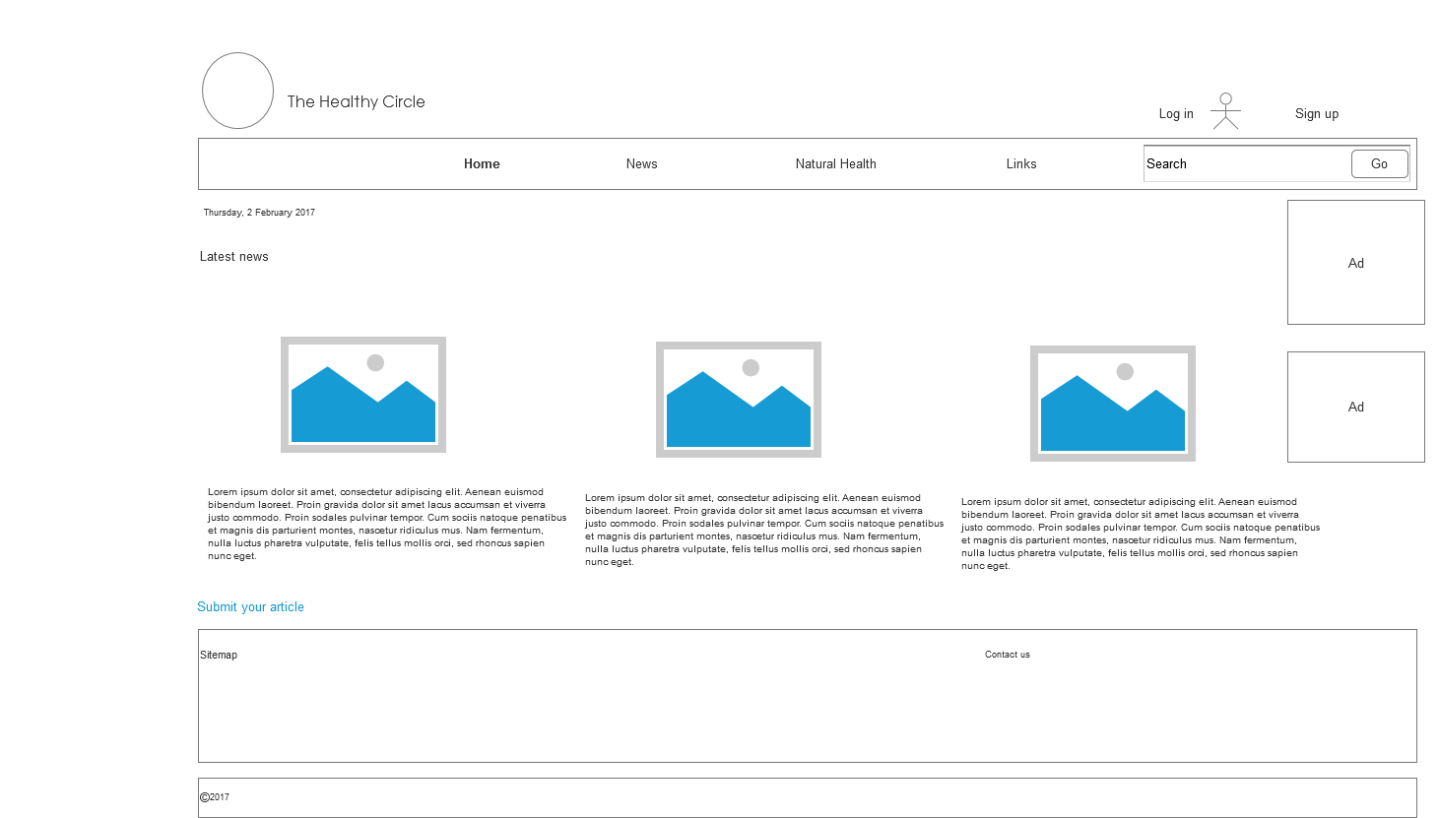
Evolving Web Technologies Ass 1: Responsive Design
Joana Roche – K00223364
__________________________________________________________________________________________________________________________________
Wireframe Prototype
1200px

Slide 7

Evolving Web Technologies Ass 1: Responsive Design
Joana Roche – K00223364
__________________________________________________________________________________________________________________________________
1200px

Slide 8
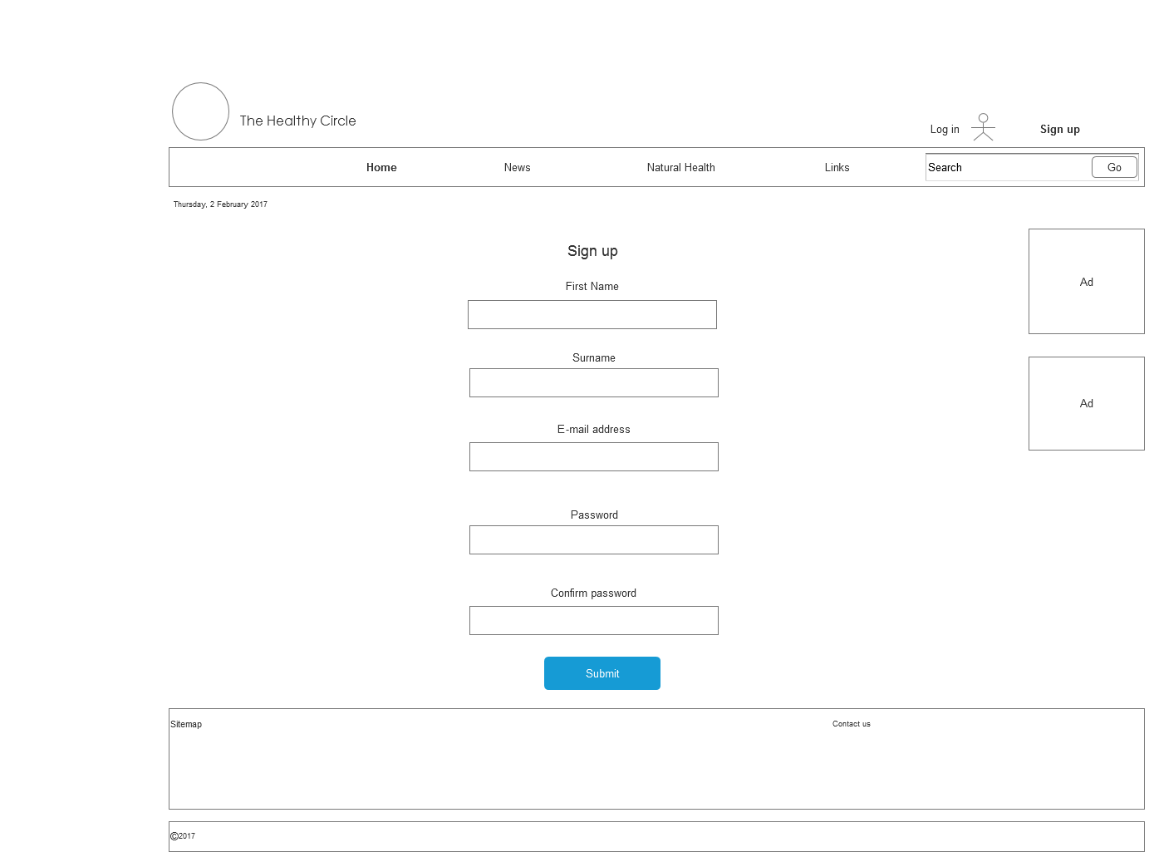
Evolving Web Technologies Ass 1: Responsive Design
Joana Roche – K00223364
__________________________________________________________________________________________________________________________________
1200px

Slide 9
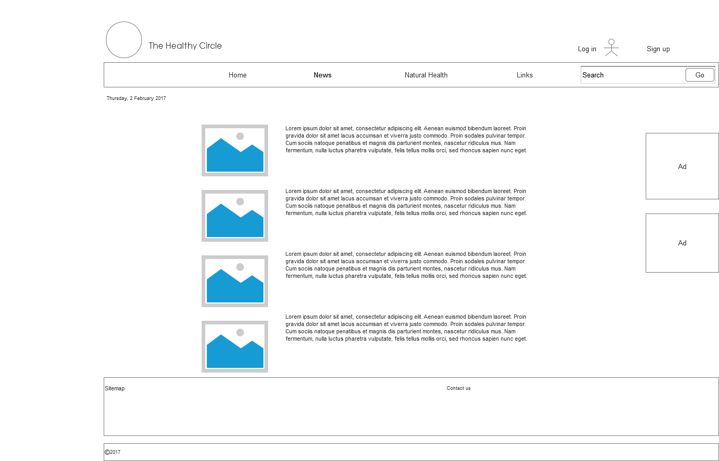
Evolving Web Technologies Ass 1: Responsive Design
Joana Roche – K00223364
__________________________________________________________________________________________________________________________________
1200px

Slide 10
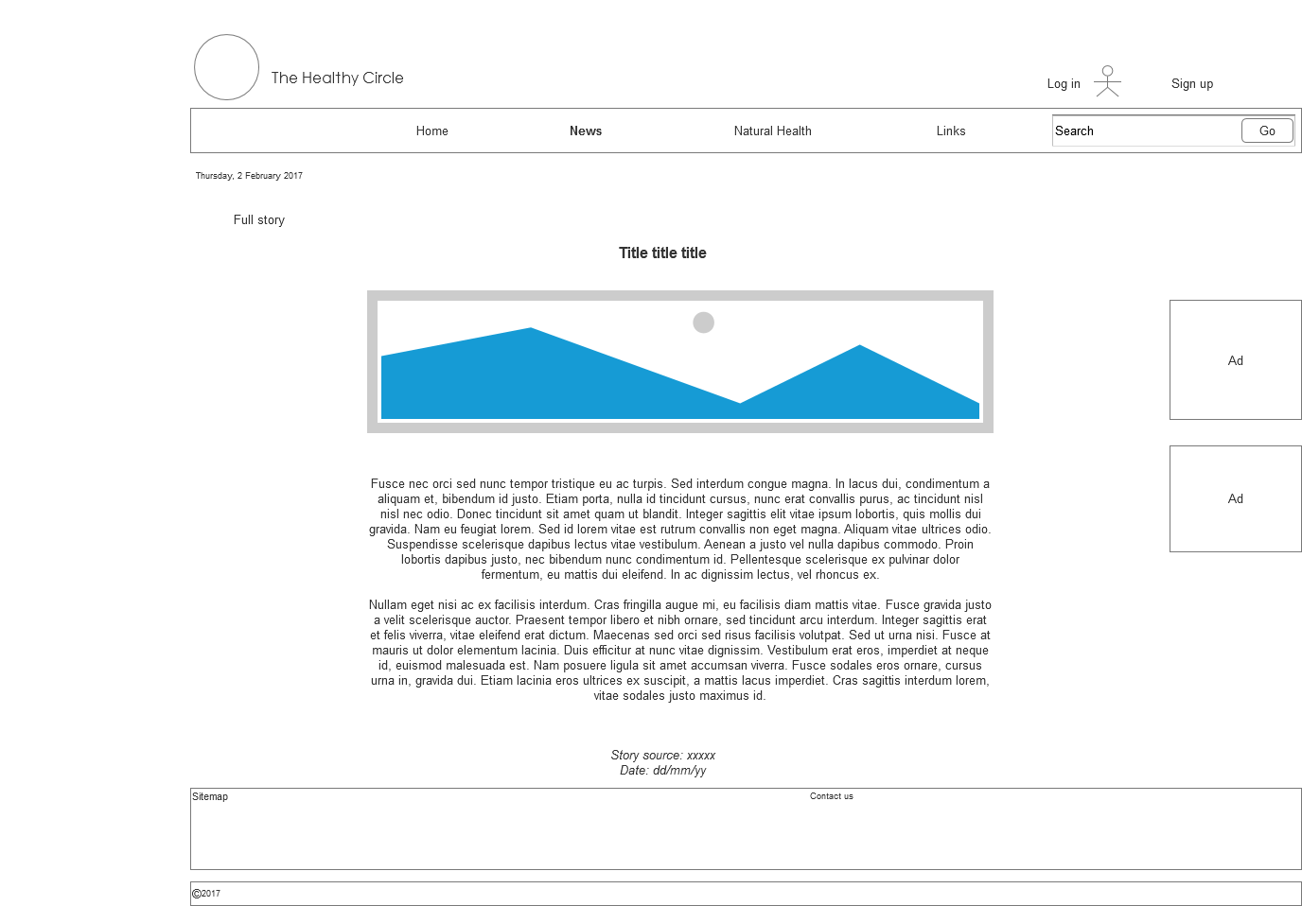
Evolving Web Technologies Ass 1: Responsive Design
Joana Roche – K00223364
__________________________________________________________________________________________________________________________________
1200px

Slide 11
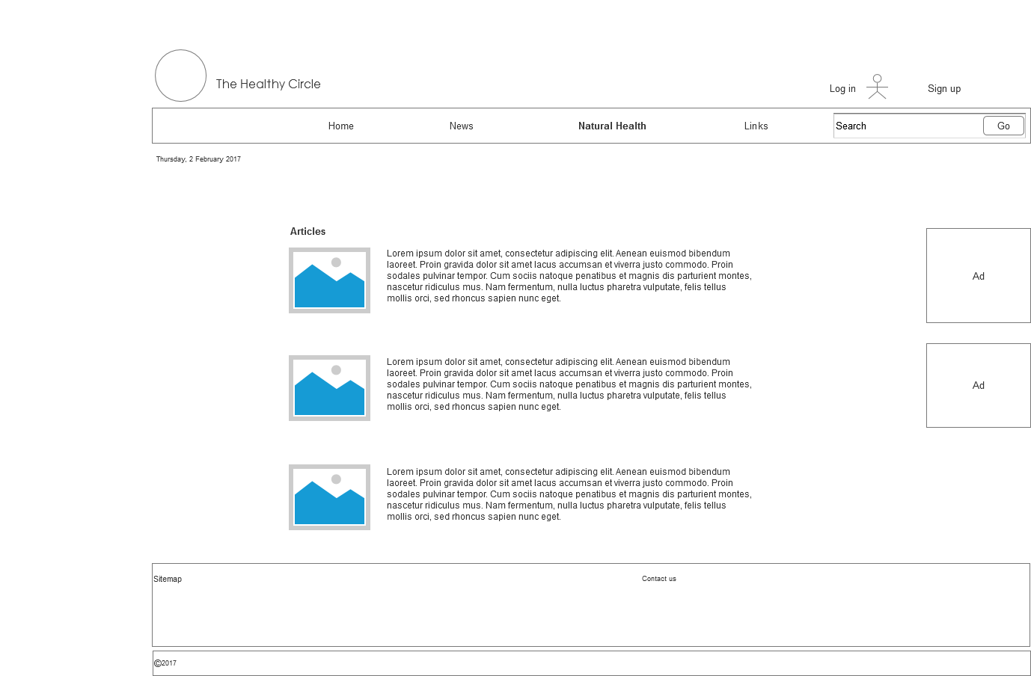
Evolving Web Technologies Ass 1: Responsive Design
Joana Roche – K00223364
__________________________________________________________________________________________________________________________________
1200px

Slide 12
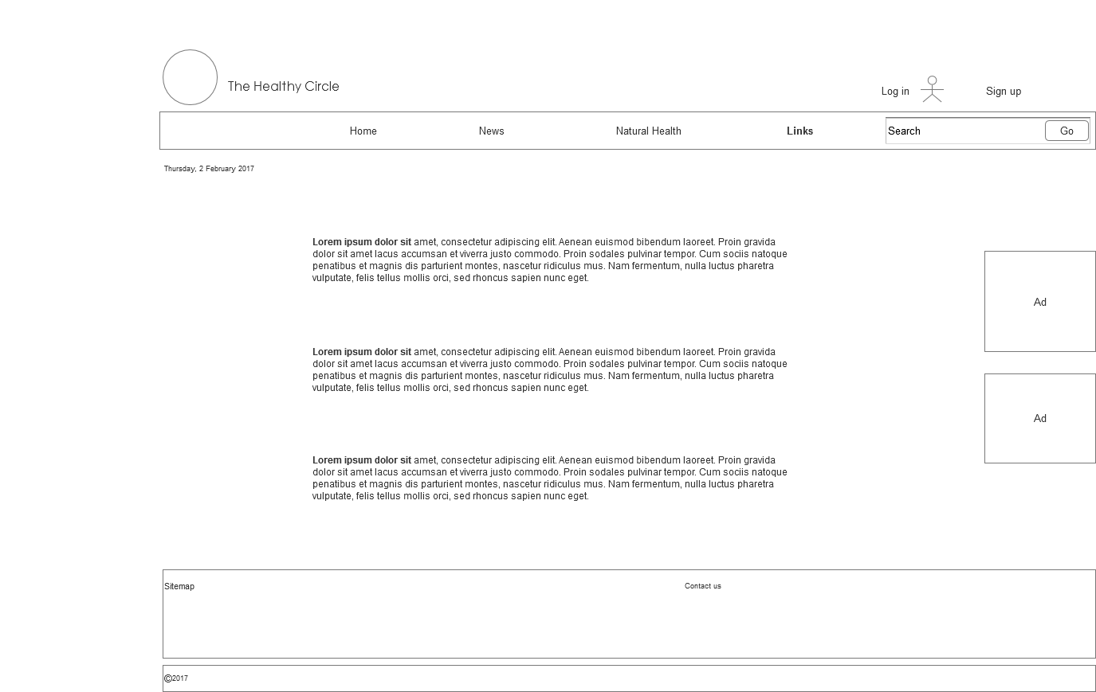
Evolving Web Technologies Ass 1: Responsive Design
Joana Roche – K00223364
__________________________________________________________________________________________________________________________________
1200px

Slide 13
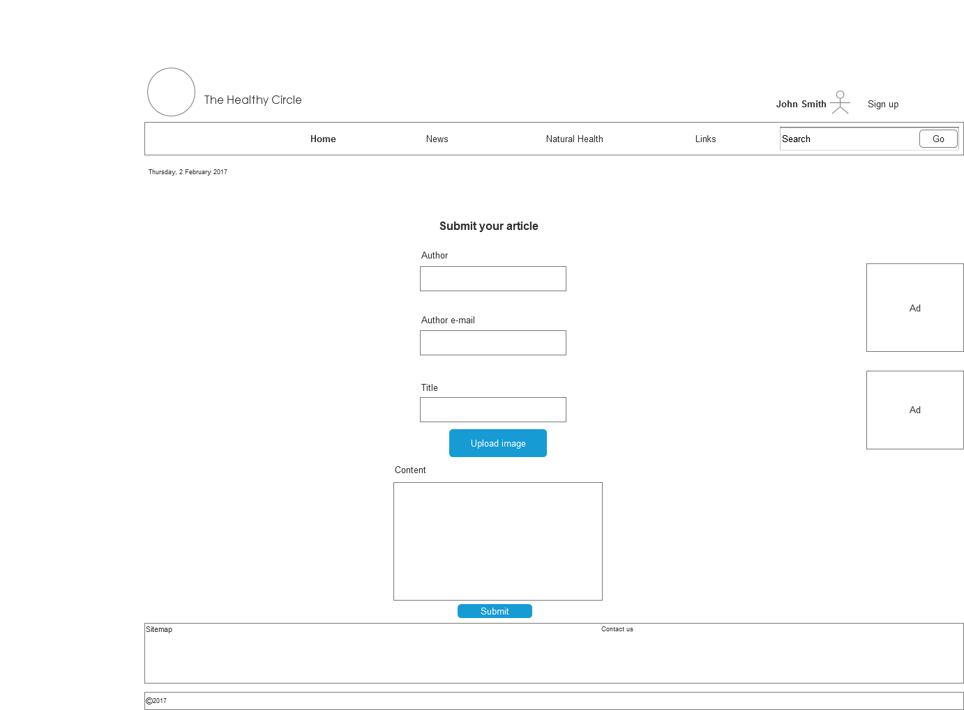
Evolving Web Technologies Ass 1: Responsive Design
Joana Roche – K00223364
__________________________________________________________________________________________________________________________________
1200px

Slide 14

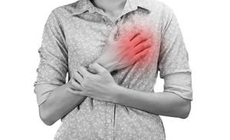

The Healthy Circle
Login
Sign up
Home
News
Natural Health
Links
Search
Thursday, 2 February 2017
Latest news
Today is World Heart Day – no better time to take stock of where we stand in our approach to cardiovascular disease, both on a national level and as individuals. Neil Johnson of Croí gives his expert opinion.
Dead swan confirmed as fourth case of bird flu outbreak
A fourth case of bird flu in Ireland has been confirmed by the Department of Agriculture.
It is the second swan that has been found to be infected with the h5n8 flu virus.
Depression may increase cancer death risk
People who develop cancer may have an increased risk of death if they also suffer with anxiety and depression, a new study has found.
Sitemap Home News Natural Health Links
Latest News Recent Articles
Nutrition
© 2017 The Healthy Circle

Slide 15
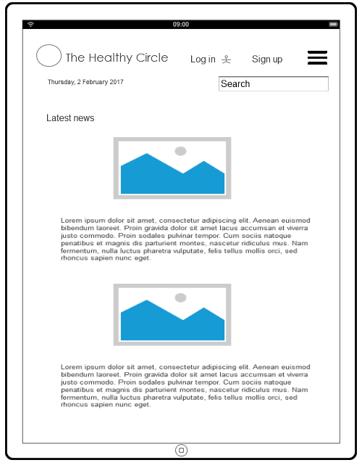
Evolving Web Technologies Ass 1: Responsive Design
Joana Roche – K00223364
__________________________________________________________________________________________________________________________________
Tablet

Slide 16
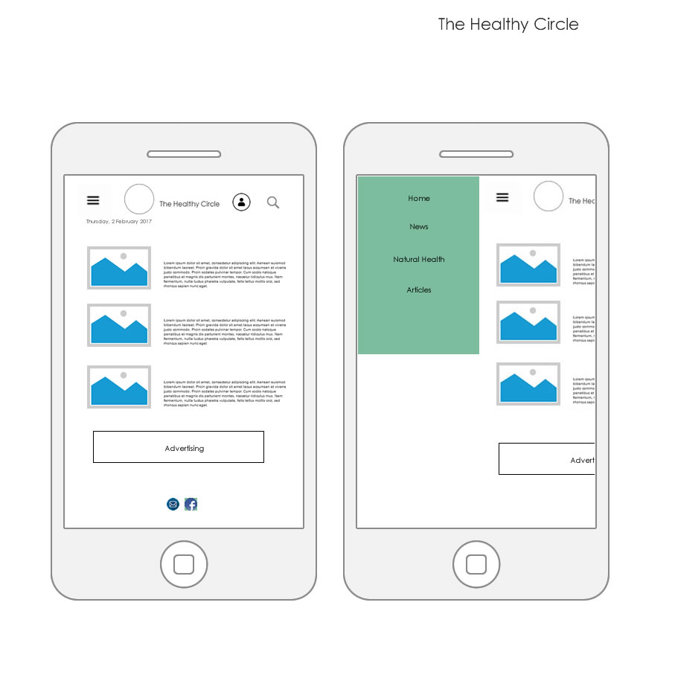
Evolving Web Technologies Ass 1: Responsive Design
Joana Roche – K00223364
__________________________________________________________________________________________________________________________________
IPhone

Slide 17
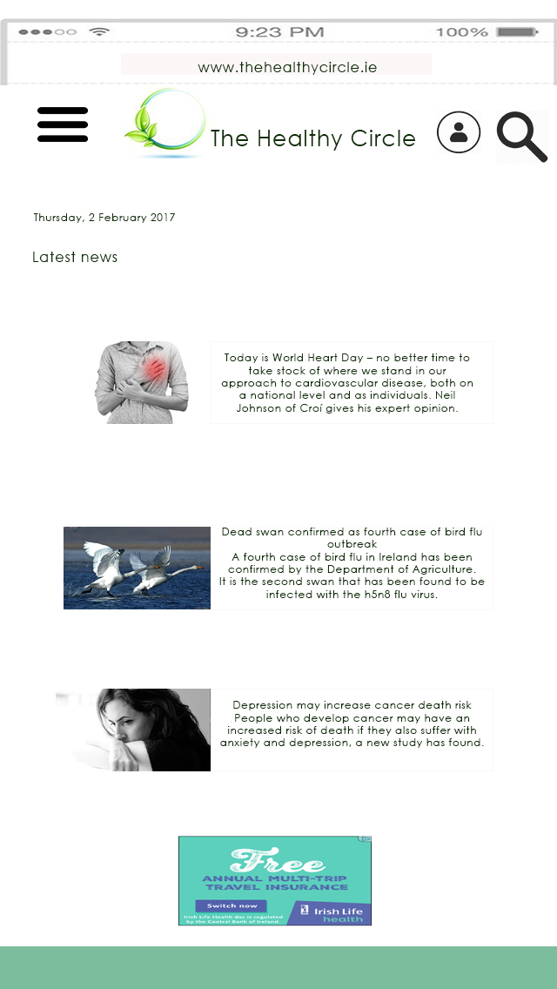
Evolving Web Technologies Ass 1: Responsive Design
Joana Roche – K00223364
__________________________________________________________________________________________________________________________________
IPhone

